Slide 1

Engaging the 21st Century Learner: The LIB 1000 Experience
David W. Young
Research Services Librarian, UNC-Pembroke
North Carolina Library Instruction Network (NCLINe) Share-Out
May 18, 2022

Slide 2
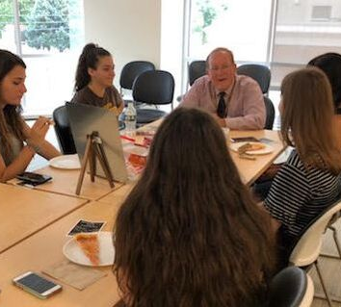
Introduction to Academic Research “Meet & Greet” activity
Activity Purpose/Rationale: Students answer 4 questions (1st day of class) to get to know me & themselves.
What is your name (first & last)?
What is your academic major?
Are you a freshman, sophomore, junior, or senior?
What are 3 goals that you have for this class?

Slide 3

Livermore Library Book Discovery
Purpose/Rationale: Introduce 21st century college students to the physical library. Through this activity, students learn the Library and how books are organized. Also, the students learn to work as a team to solve problems.
Students meet in Library classroom. Work in teams to record the call numbers under the “book clue” sheets that I give them.
Students go out to Library stacks in teams of 3 and locate actual books.
Students pull slips of paper with questions to answer about each book on their “clue sheet”
Students bring completed sheet back to me.

Slide 4
APA (7th ed.) Citation Relay Using Moveable Whiteboards
Activity Rationale: Give LIB 1000 students a “fun competition” method to learn APA (7th ed.) citations using 3 white boards for 3 teams
Team Names: “Needles in the Book Stacks”; “Fiction Addiction,” “It’s a Hardback Life”
Each team has a “searcher” and a “runner” & there are usually book & journal article problems.
The designated “runner” for the team gets the citation information from the searcher and runs to the white board to complete citation. There are 15-18 total problems.
Professor Young and 2 Librarian colleagues serve as “judges”

Slide 5
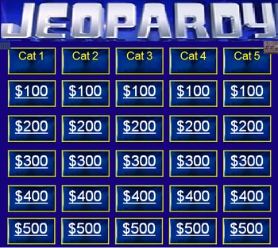
Let’s Play LIB 1000 Jeopardy!
Activity Purpose/Rationale: A fun way for LIB 1000 students to show knowledge of course content.
Program called Jeopardy Labs (https://jeopardylabs.com) used to create game board and there are usually 5 categories & 2 rounds
Round 1 categories: Citation Missing Links; Textbook vocabulary; Find it in Primo; Canvas, Syllabus, or Library?; 3-R & CRAAP Method
Round 2 categories: What’s Wrong?; Source Types, Text Vocabulary, Find it in ASU; Evaluative Bibliography

Slide 6

Research Autobiography Discussion Board
Activity Purpose/Rationale: Students reflect about their research “experience.”
What has been your research experience?
Do you like doing research? Why or why not?
Do you have a favorite go to source?
Have you used library databases in the past?
What citation style are you more familiar with (APA or MLA)?
Do you know what citation style your academic major uses?

Slide 7

My Library Experience Discussion Board
Activity Purpose/Rationale: Students reflect on their own experience in using college libraries.
Do you avoid using library webpages, because you don’t understand them?
Do you enjoy studying in libraries? Why or why not?
What has been your experience in asking library staff for help when you needed it?

Slide 8

Mid-Semester Discussion Board
Activity Purpose/Rationale: Students use selected questions to reflect on and discuss their experience at the midpoint of the Introduction to Academic Research course.
In your opinion, what are some of the most important skills or research tools that you have learned about in this LIB 1000 course so far?
In your opinion, do you feel that this course can help you already in your academic major here @ UNC Pembroke? Why or why not?
Are you more comfortable searching library databases or accessing books/journal articles in Primo? Why or why not?

Slide 9

Chapter Reflections
Activity Purpose/Rationale: Students provided list of key chapter concepts and then choose from a list of related questions to write a short reflective essay.
“In this chapter, you learned about the following concepts:
Keyword searching in Primo
Research logs: function & importance
Concept maps: function & importance
Keyword truncation as search technique

Slide 10

Chapter Reflection (Cont.)
Now, write a reflective essay (60 words minimum) where you answer 3 of the following 4 questions:
How can students use keyword truncation, research logs, Boolean operators (connector terms like AND, OR, NOT) in their academic major or in their lives?
As you think about research logs, what are some benefits to students of keeping a research log for any academic assignment?
In your own opinion, what is the function or purpose of a concept map and how might drawing a concept map help students on research assignments?
Are some of the chapter concepts listed above more beneficial for college students than other research tools? Why or why not?”

Slide 11

Questions?

